Slide 1
Chapter 12: I/O, 8255 and Device Interfacing, Part 2
CSE 3442
Tom Rethard

Slide 2
8255 Mode 1: Handshaking
As with a printer
  Put byte of data on data bus of printer
  Tell the printer the byte is there – activate STROBE input signal
  Printer acknowledges data receipt by activating an ACK output
  ACK re-initiates the cycle

Slide 3
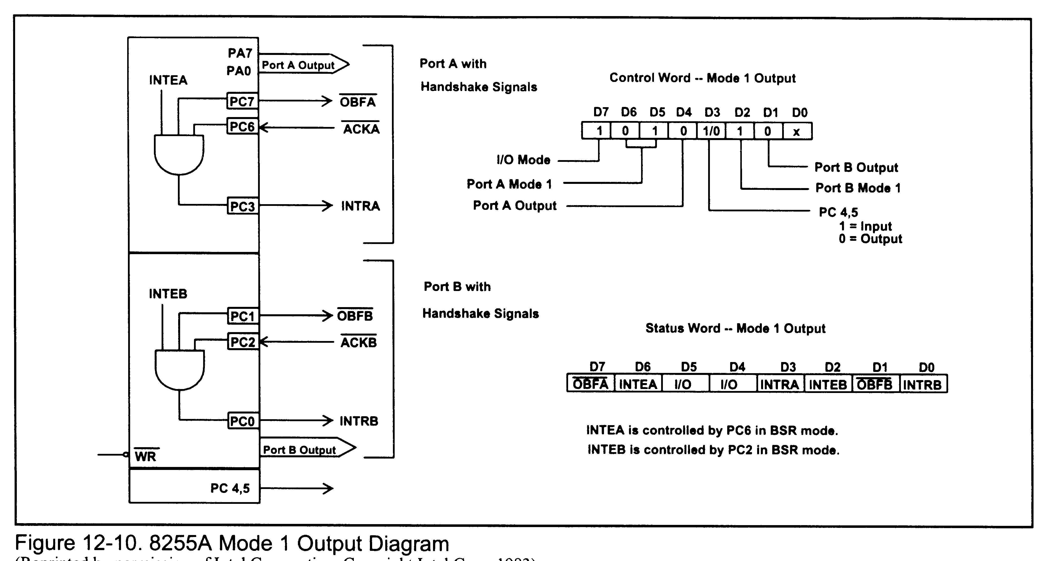
Mode 1 Output

Slide 4
Mode 1 Out – Relevant Signals
OBFa
  Output buffer full for port A
  Out on PC7
  Should be connected to printer STROBE input
ACKa
  Acknowledge for Port A
  Received on PC6
  Set low again when OBFa goes high

Slide 5
Mode 1 Out – Relevant Signals
INTRa
  Interrupt request for Port A
  Makes OBFa inactive
  Rising edge of ACK activates it
  Interrupts CPU to allow it to write next byte to Part A

Slide 6
Mode 1 Out – Relevant Signals
INTEa
  Interrupt enable for Port A
  Can be used to disable interrupts temporarily
  Set/Reset through Port C (PC2)
Status word
  Read into port C and test bits

Slide 7
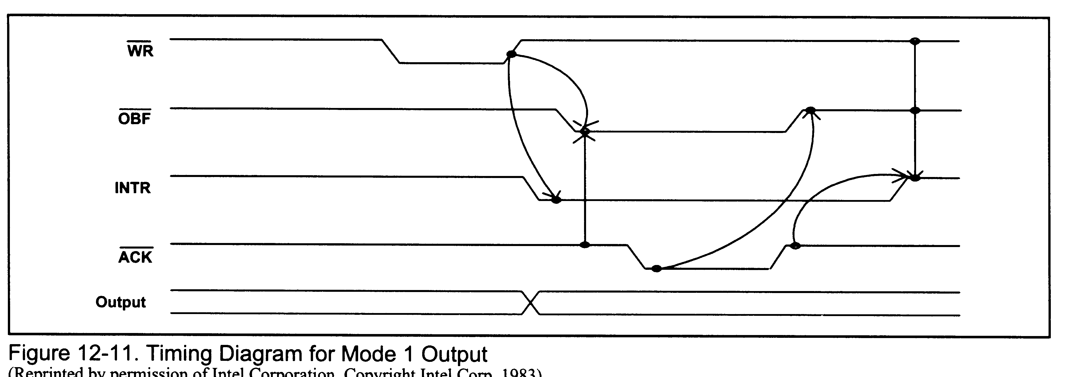
Mode 1 Timing

Slide 8
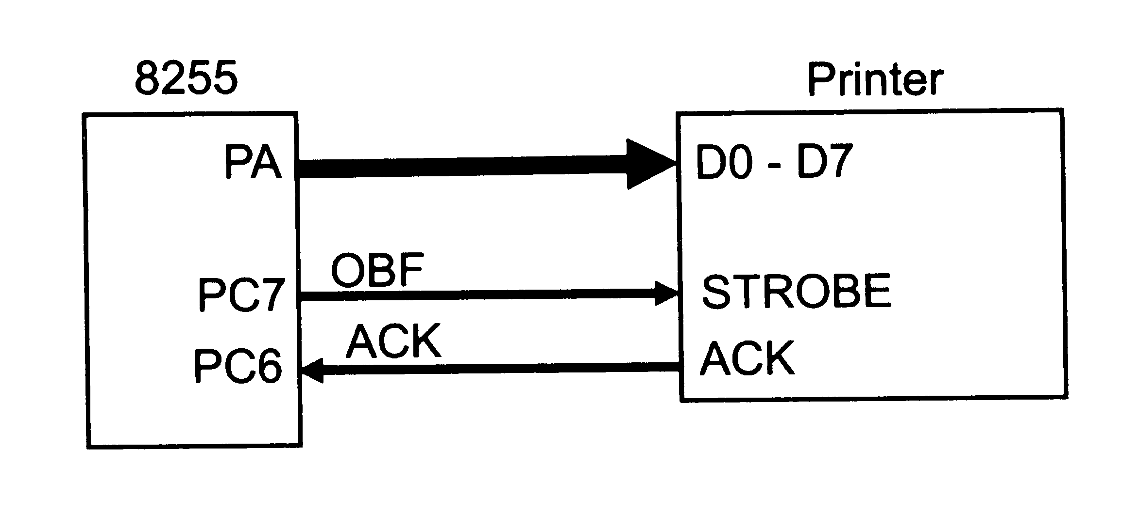
Example 12-9 - Printer

Slide 9
Interrupts vs. Polling
Either way can be used to communicate with a device
Polling
  CPU has to constantly check to see if device is ready for another byte
Interrupt
  Does not require constant attention from CPU
  Allows more devices to be serviced easily
  Requires more hardware and more sophisticated software
  This is the preferred answer, but it’s not always possible.

Slide 10
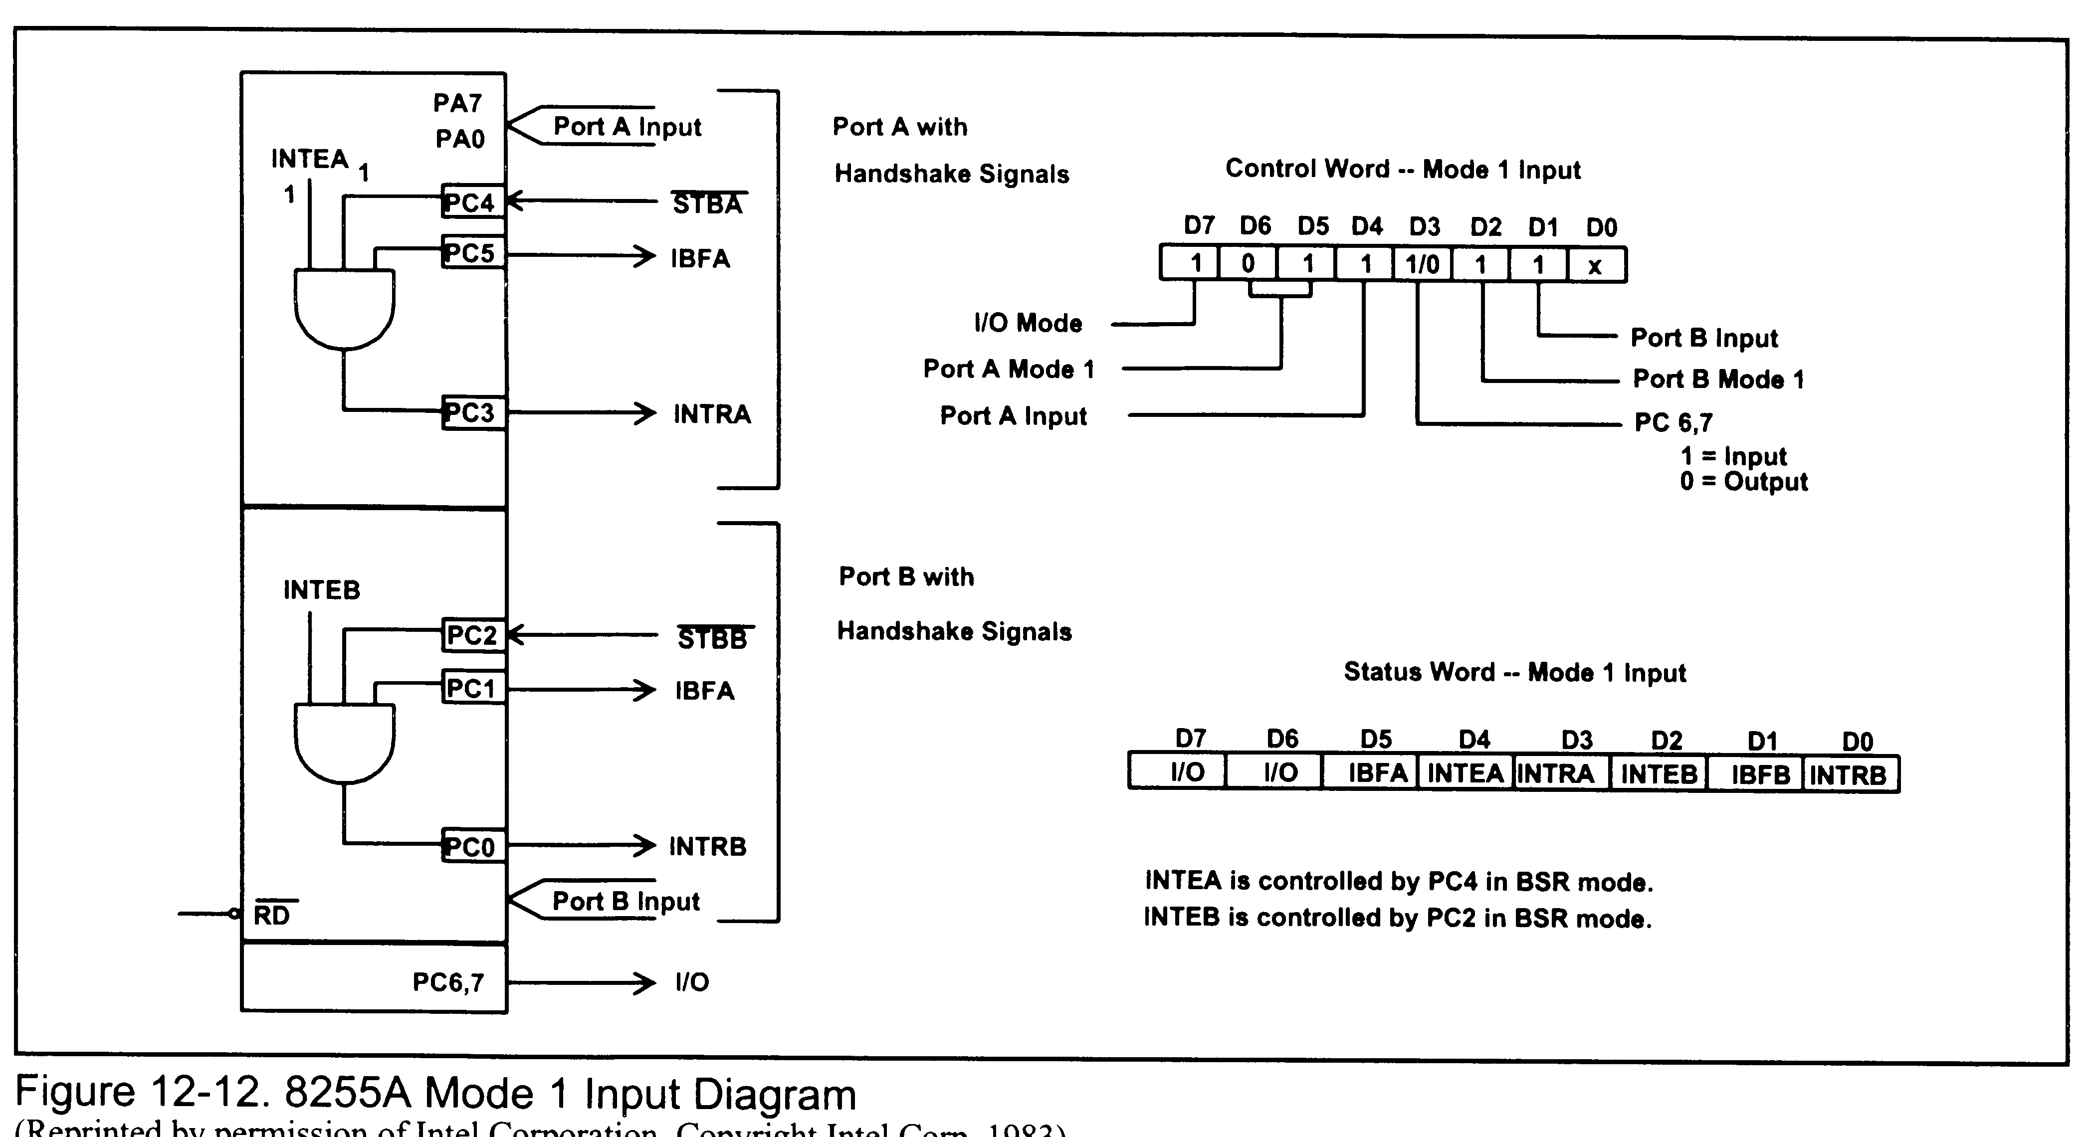
Mode 1 Input

Slide 11
Mode 1 In – Relevant Signals
STB
  Strobe
  Informs 8255 that a byte is available
IBF
  Input buffer full
  Response to Strobe
  Indicates data has been copied to 8255, but not send to CPU yet

Slide 12
Mode 1 In – Relevant Signals
INTR
  Interrupt request
  Informs CPU that a byre is available unless masked
  CPU reads with RD, whose falling edge makes INTR go low.
INTE
  Interrupt enable
  Controlled by PC4 and PC2

Slide 13
Mode 1 In – Relevant Signals
Status Word
  Used to implement polling
  Port C

Slide 14
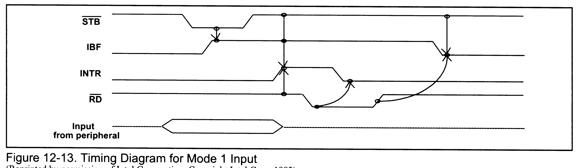
Mode 1 Input Timing

Slide 15
Mode 2 Bi-directional I/O
Transfer data in and out on same port (Port A)
Handshaking signals on Port C

Slide 16
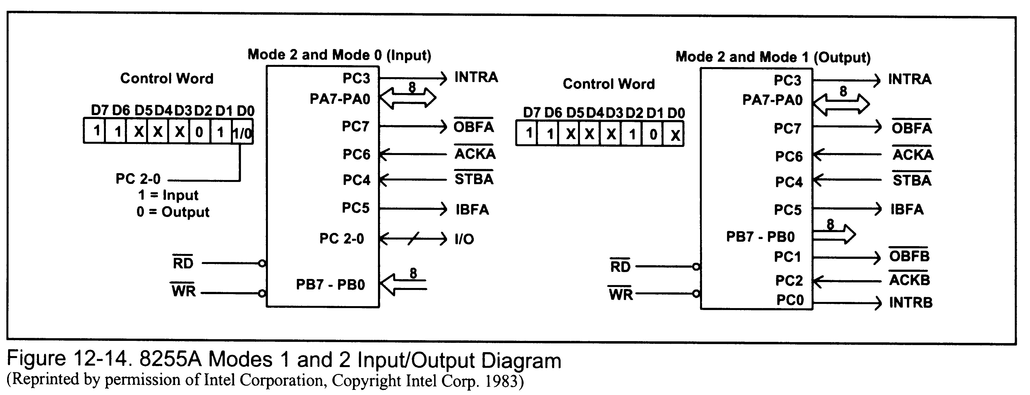
8255A Modes 1 & 2 I/O

Slide 17
Mid Term Exam
Wednesday (day after tomorrow)
Closed book, closed notes, closed calculators, closed mouth
Any needed reference materials will be supplied with the test
Ink answers only; any answer written in pencil will be counted incorrect.
Assigned seating

